Slide 1
TEMPDB CONTENTION HOW TO IDENTIFY AND RESOLVE IT
Haripriya Naidu
She/Her
SQL DBA

Slide 2

About me
SQL Database Administrator – 10 years
SQL Server Engine Internals
Performance Tuning
AWS Certified Solutions Architect
Rookie of the Year @Work

Slide 3
Agenda
Uses of TempDB
Types of Contention
Identifying Contention
Ways to Resolve

Slide 4
Why learn about TempDB Contention
Troubleshoot Slowness
Concurrency Management

Slide 5
Why is Contention on TempDB
Create/Insert/update/Delete transactions
Create/Insert/update/Delete transactions
100X
UserDB
TempDB

Slide 6
What runs on TempDB
User Objects
Version Stores
Internal Objects

Slide 7
User objects
Local and Global Temp Tables - #table, ##table
Local and Global Temp Stored Procedures - #proc, ##proc
Table Variables - @table
Appear in sys.all_objects view

Slide 8
Internal objects
Worktables to store intermediate results for
Sorts, Hash Joins, Aggregates
Spools, Cursors
INSTEAD OF triggers
Store Service Broker messages in transit
Online Index Rebuild when SORT_IN_TEMPDB is ON
Users cannot create these internal objects

Slide 9
Version Stores
Used for Row versioning for the following:
Snapshot isolation levels
Online index operations
AFTER triggers
MARS(Multiple active result sets)

Slide 10
Types of Contention
Object Allocation Contention – DML
Metadata Contention – DDL
Temp Table Cache Contention

Slide 11
Object Allocation Contention - DML
Insert/Update/Delete transactions on temporary objects need a latch on PFS, GAM, SGAM pages, causing contention

Slide 12
Datafile – tempdb.mdf
Page 0: File Header
Page 1: Page Free Space (PFS)
Page 2: Global Allocation Map (GAM)
Page 3: Shared Global Allocation Map (SGAM)
Page 4: Unused
Page 5: Unused
Page 6: Differential Change Map (DCM)
Page 7: Bulk Change Map (BCM)
Data pages
… <more data pages>
Tracking pages
Track the status of data pages
To allocate objects
Data pages

Slide 13
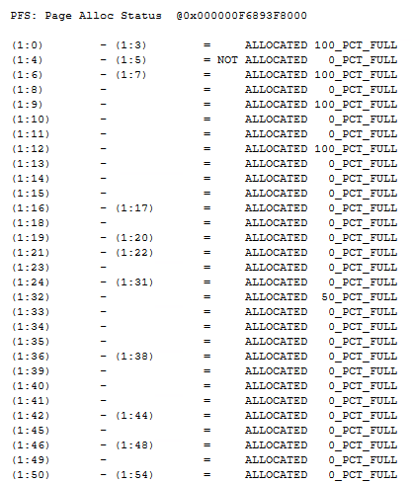
Page Free Space (PFS)
Page 1: PFS
Tracks free space available for each page
All operations need a latch on PFS page to know which page has space

Slide 14
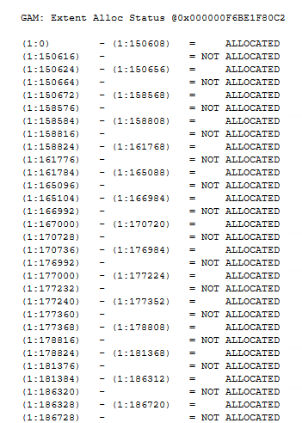
GAM (Global Allocation Map)
Page 2: GAM
Tracks if an uniform extent is allocated or not
All operations need a latch on GAM page to know which page is allocated or not

Slide 15
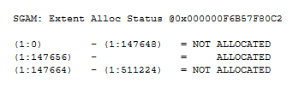
SGAM (Shared Global Allocation Map)
Page 3: SGAM
Tracks if a mixed extent is allocated or not
All operations need a latch on SGAM page to know which page is allocated or not

Slide 16

Multiple transactions hit on a datafile
PFS
Page 1
GAM
Page 2
SGAM
Page 3
data pages
PFS 2
Page 8088
data pages
GAM 2
Page 511232
SGAM 2
Page 511233
Tempdb.mdf
https://gohigh.substack.com/p/pfs-gam-sgam-pages

Slide 17
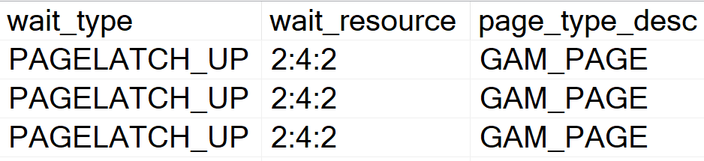
Identify Object Allocation Contention
PAGELATCH_UP, PAGELATCH_SH waits on 2:FileID:<PFS or (S)GAM page>

Slide 18
Resolve Object Allocation Contention
Multiple Transactions
Transactions are spread across multiple datafiles
Allocation 1
Allocation 2
Allocation 3
Allocation 4
PFS
PFS
PFS
PFS
PFS
GAM
GAM
GAM
GAM
GAM
SGAM
SGAM
SGAM
SGAM
SGAM
data pages
data pages
data pages
data pages
data pages
Allocation 5
Allocation 6
Allocation 7
Allocation 8
PFS 2
PFS 2
PFS 2
PFS 2
PFS 2
data pages
data pages
data pages
data pages
data pages
GAM 2
GAM 2
GAM 2
GAM 2
GAM 2
SGAM 2
SGAM 2
SGAM 2
SGAM 2
SGAM 2
Tempdb.mdf
Tempdb.mdf
Tempdb_1.ndf
Tempdb_2.ndf
Tempdb_3.ndf

Slide 19
Resolve Object Allocation Contention
Round Robin across datafiles and PFS pages
Create 1 data file per processor up to 8 processors
Increase datafiles in additional numbers of 4 as needed
Create with same size and same autogrowth
Proportionally fills datafiles based on empty space

Slide 20
Resolve Object Allocation Contention
SQL 2016 and onwards: Trace Flags 1117, 1118 ON by default
SQL 2019: PFS page => exclusive to shared latch
SQL 2022: GAM and SGAM pages => exclusive to shared latch
Follow best practices across all versions

Slide 21
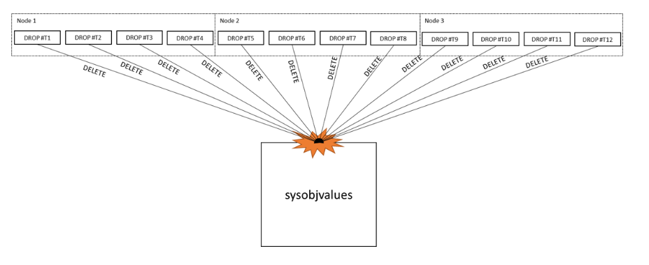
Metadata Contention – DDL
Create/alter/drop on temporary objects need a latch on system object pages, causing contention
https://learn.microsoft.com/en-us/archive/blogs/sql_server_team/tempdb-files-and-trace-flags-and-updates-oh-my

Slide 22
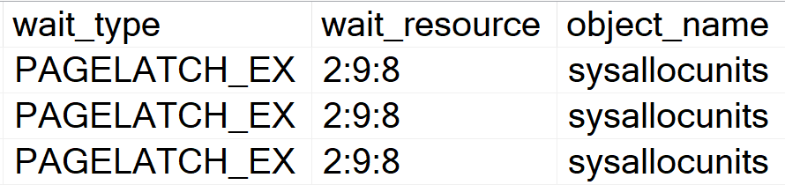
Identify Metadata Contention
PAGELATCH_EX, PAGELATCH_SH waits on 2:FileID:<system page>

Slide 23
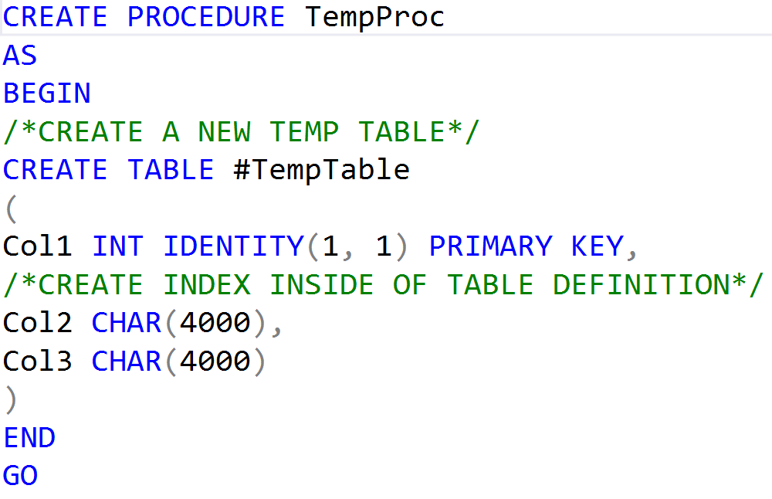
Resolve Metadata Contention
Don’t drop/truncate temp tables
Cache temporary objects:
Don’t alter temp table DDL statements after creation
Create indexes inline with table definition
Create temp objects within SP, trigger, function

Slide 24
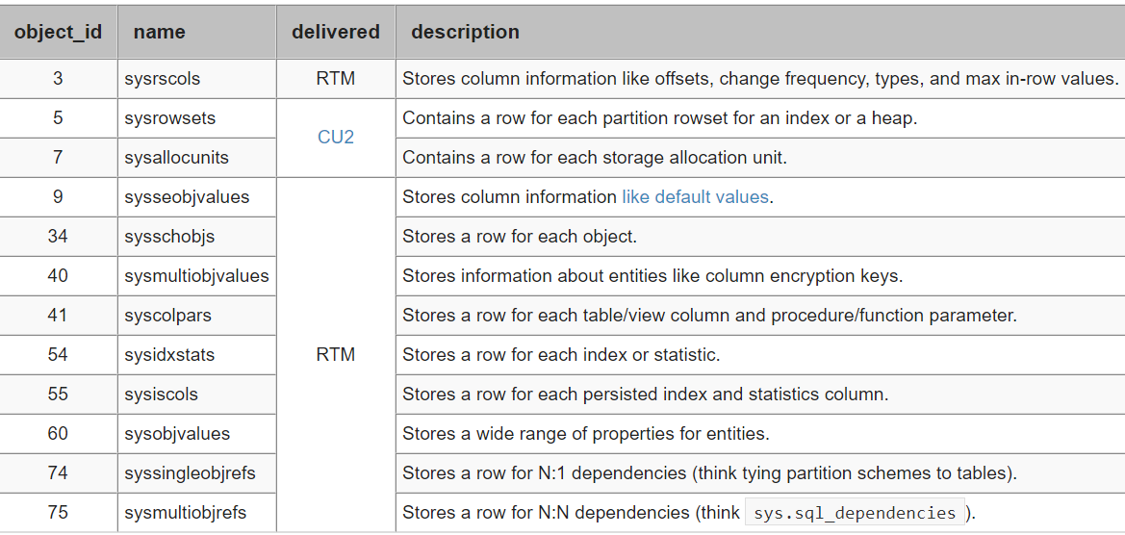
Resolve Metadata Contention - Contd
Enable Memory-Optimized TempDB Metadata starting SQL 2019
Not ON by default
CU2 moves sysallocunits, sysrowsets
https://www.mssqltips.com/sqlservertip/6230/memoryoptimized-tempdb-metadata-in-sql-server-2019/

Slide 25
Temp table cache contention
Contention on cache for Temp table memory objects
Inefficient usage of Hash tables in cache
Identify/Resolve:
CMEMTHREAD waits
SOS_CACHESTORE spinlock waits
Open a Microsoft case, needs advanced debugging

Slide 26
DEMO

Slide 27
Summary: Object Allocation Contention
Observe: PFS, GAM, SGAM pages
Wait Type: PAGELATCH_UP, PAGELATCH_SH
Resolution:
Multiple datafiles
Upgrade to SQL Server Version 2022
Version:
Mitigated in SQL 2019
Resolved in SQL 2022 by default

Slide 28
Summary: Metadata Contention
Observe: System object pages
Wait Type: PAGELATCH_EX, PAGELATCH_SH
Resolution:
Don’t drop temp objects
Cache temp objects
Turn ON in-memory TempDB metadata feature
Version:
Resolved manually in both SQL 2019 and SQL 2022

Slide 29

Summary: Temp Table Cache Contention
Observe: Huge memory objects in cache
Wait Type: CMEMTHREAD, SOS_CACHESTORE
Resolution:

Slide 30
Why learn about TempDB Contention
Troubleshoot Slowness
Concurrency Management

Slide 31
Resources
TempDB: The Good, The Bad, and The Ugly by Pam Lahoud
https://youtu.be/5jpfy19yl7k?si=vmgf3zqxokurpeo0
OStress utility: https://learn.microsoft.com/en-us/troubleshoot/sql/tools/replay-markup-language-utility
Klaus Aschenbrenner: https://www.sqlservercentral.com/blogs/improved-temp-table-caching-in-sql-server-2014
Pro SQL Server Internals book by Dmitri Korotkevitch

Slide 32




Reach out for more questions
haripriya.naidu1@gmail.com
haripriya-naidu1215
github.com/haripriyasb/tempdb
gohigh.substack.com

Slide 33
Q & A!

Slide 34
Thank You!

